Slide 1
Probability & Random Processes EE2011 Department of Electrical Engineering
NATIONAL UNIVERSITY OF COMPUTER & EMERGING SCIENCES, LAHORE CAMPUS

Slide 2





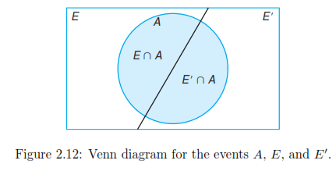

Slide 3






Slide 4
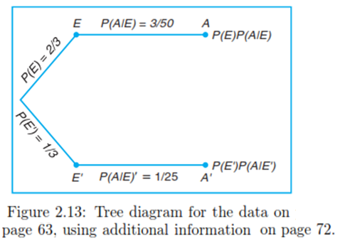

Slide 5

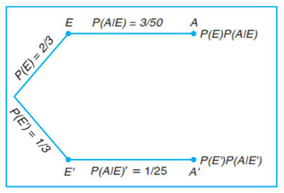




Slide 6
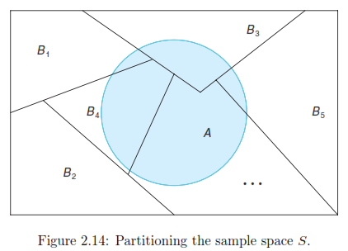



Slide 7




Slide 8




Slide 9

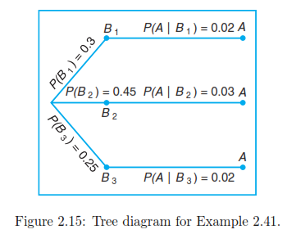


Slide 10



Slide 11



Slide 12




Slide 13





